Slide 1

COMPUTER SOFTWARE
Computer Fundamentals Lab 2

Slide 2
What is Software?
A collection of instructions that tells a computer what to do.
Software is written in high or low level computer languages called programming languages.

Slide 3
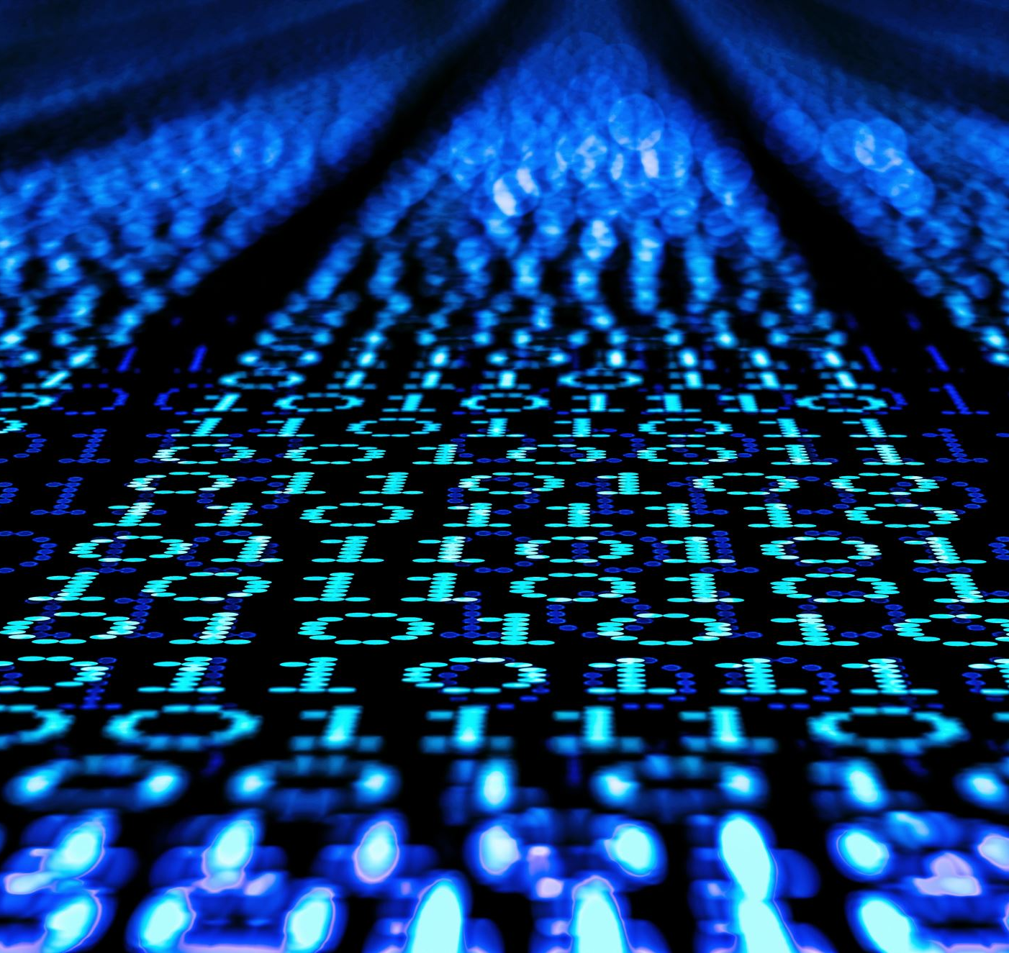
Programming languages
A formal language comprising a set of strings that produces various kinds of machine code output.
They are computer languages used to implement algorithms and develops software.
Common types include C, assembly, Python etc.

Slide 4

Types of Software
Application Software
System Software
Malicious Software
Firmware

Slide 5
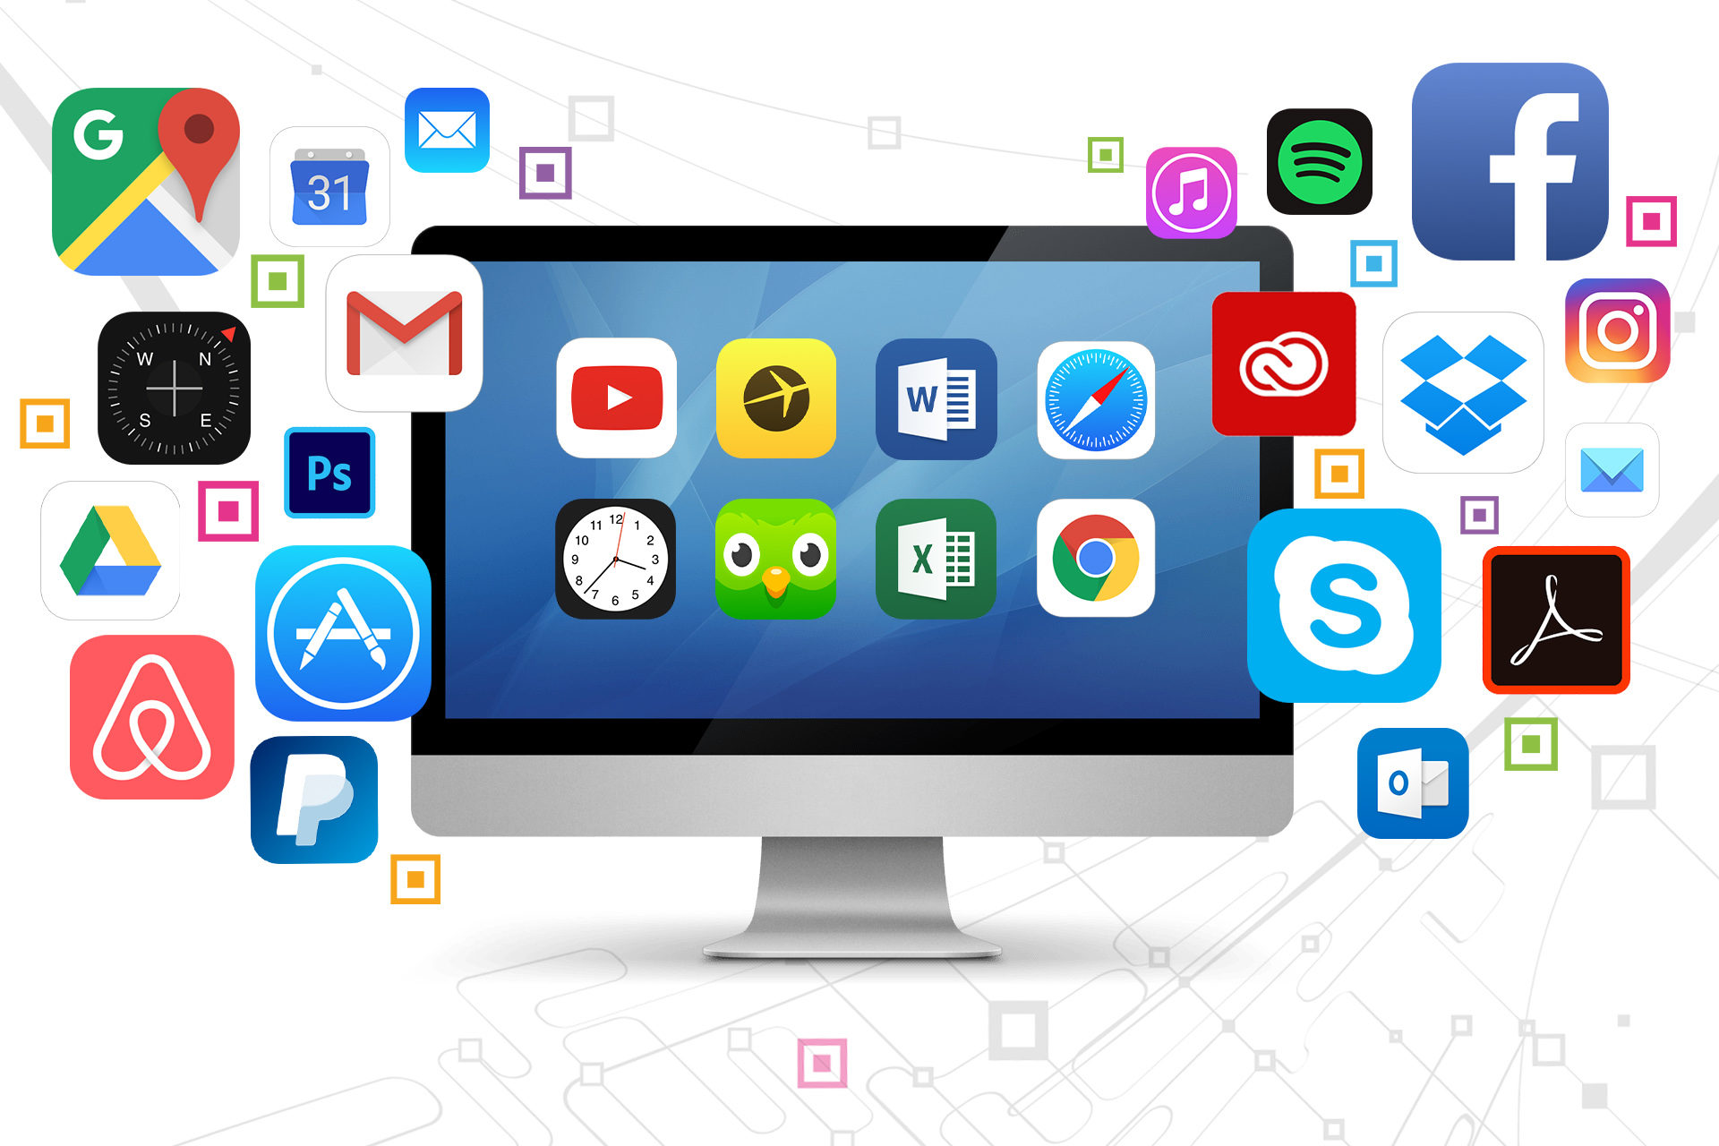
Application Software

Slide 6
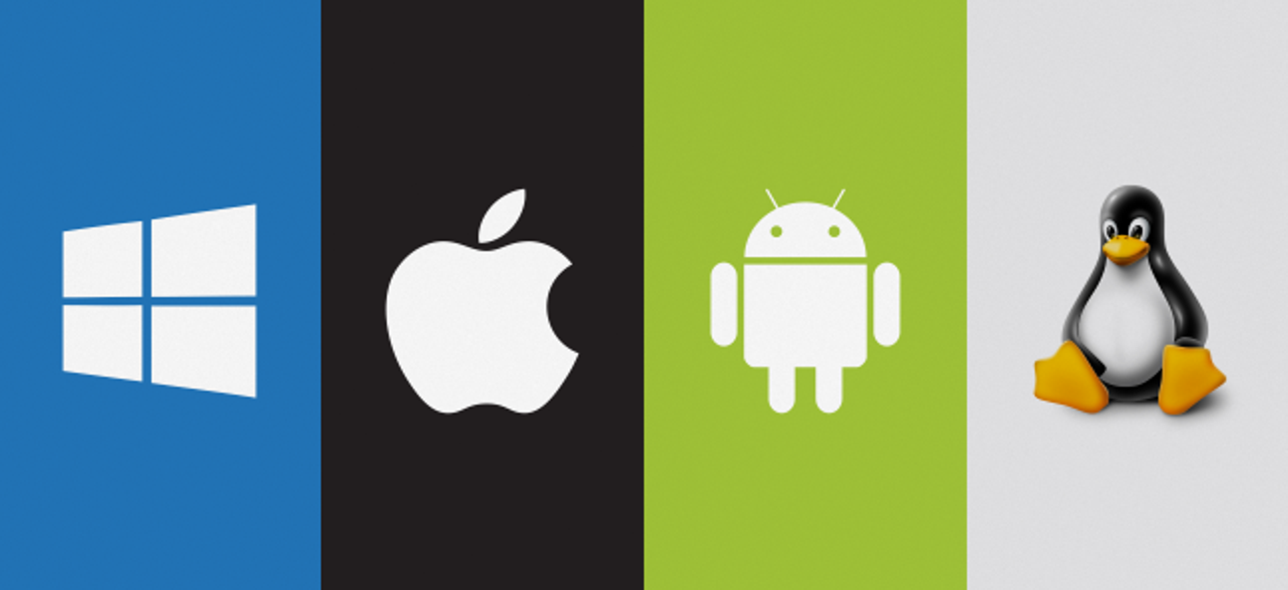
System Software

Slide 7
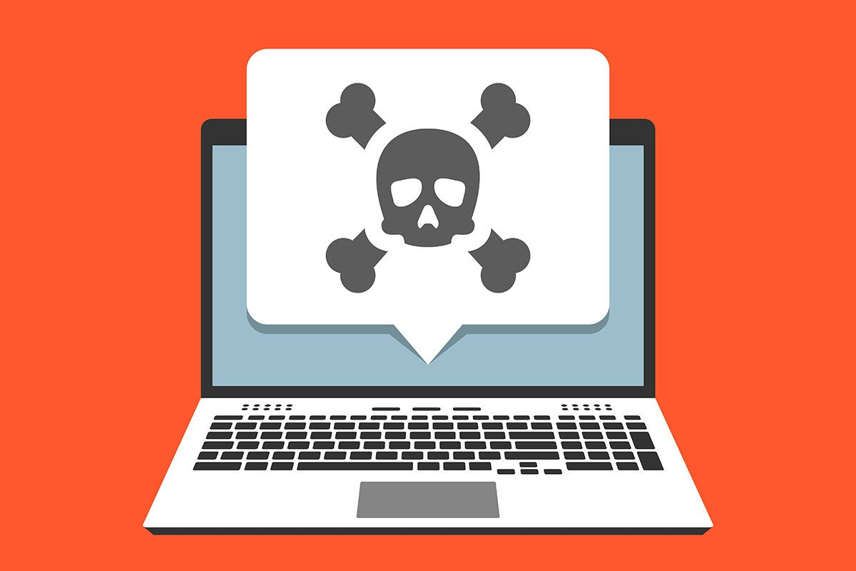
Malicious Software

Slide 8
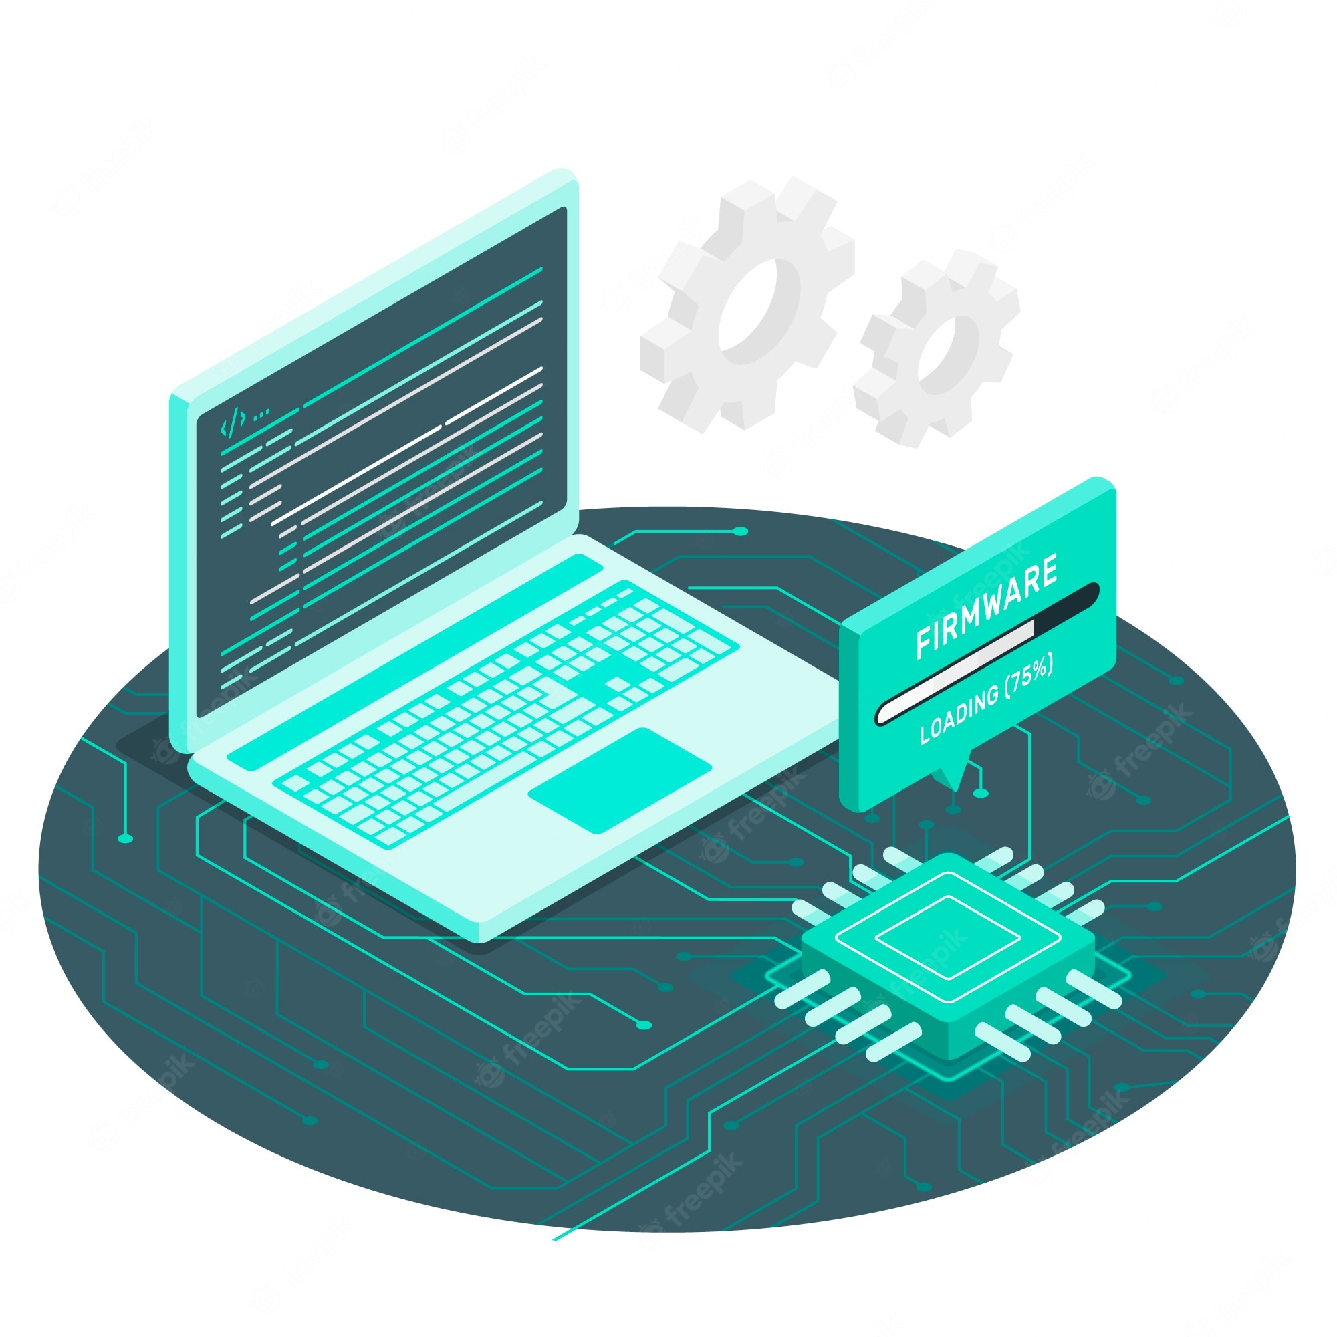
Firmware

Slide 9
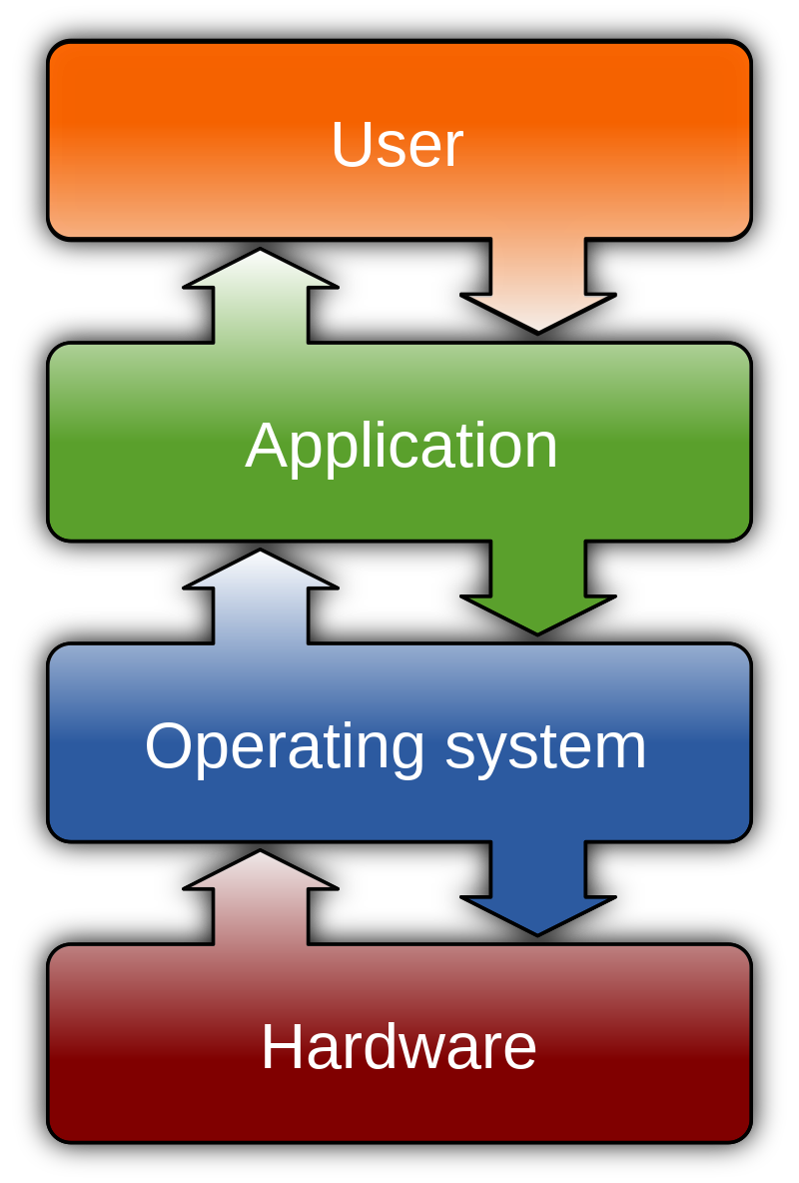
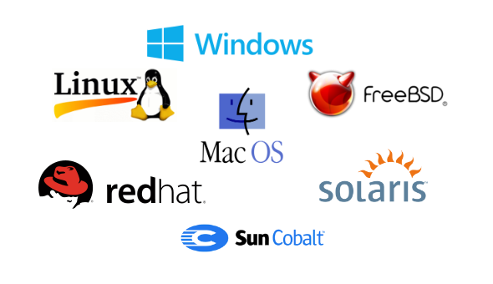
Operating Systems

Slide 10
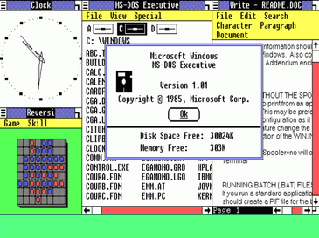
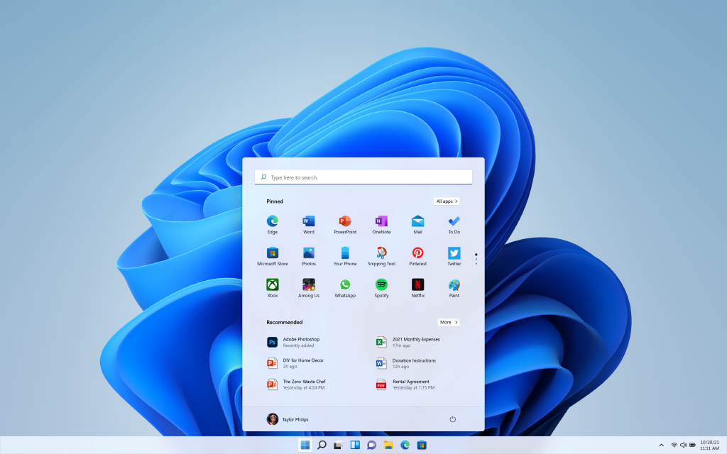
Windows NT based

Slide 11
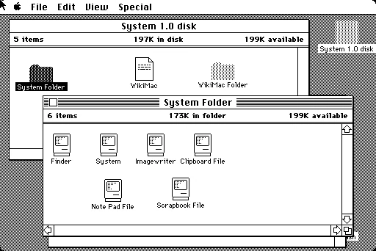
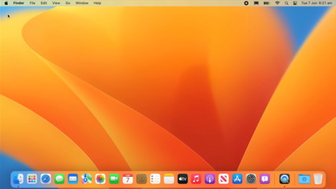
Unix based

